Slide 1
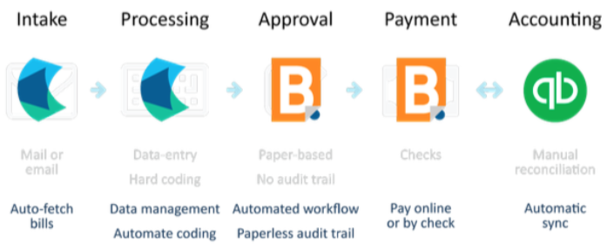
Michigan Statewide Independent Living Corp.
Financial Management System (effective April 2019)
Tools and Process:
Hubdoc
Hubdoc
Bill.com
Bill.com
QuickBooks
Cloud based filing to capture all bills and documentation
“auto fetch” bills from vendors
SILC leadership has access in addition to accountant
Automated coding to financial systems
Source copies of bills and statement sent to accounting system (audit trail)
Automatically backed-up and accessible
Accountant ensures all bills are ready to pay
Approvals performed by SILC leadership, not accountant, for segregation of duties
Bill.com has highest level of security built in, same as your bank or higher
Payments made electronically or by check sent by bill.com. No manual checks.
Accountant has no access to bank account. SILC leadership maintains connection from bank to bill.com
Accounting system automatically updates from bill.com and Hubdoc
SILC leadership has access to accounting system to review reports and transactions
SILC leadership to do a monthly bank reconciliation review in the system
Payroll processing outsourced to payroll service provider. Enables accountant to be a control review
Summary of Key Controls:
Accountant does not have access to bank account
SILC leadership required/forced to approve all transactions
SILC leadership has access to the financial system (QuickBooks)
All data (QuickBooks) is backed up in the cloud as opposed to on single computer accessible to only the accountant
Payroll outsourced to payroll service provider for segregation of duties. Both accountant and SILC leadership review actual payroll before finalized
Audit trail with actual source documentation exist within the systems
Other overall highlights:
Accountant is insured at required levels. Insurance includes professional liability, cyber and crime insurance
Accountant is part of a franchise system following industry best practice procedures
Tools used are best-breed enabling automation and efficiency that benefits SILC in terms of budget along with strong security controls

